Slide 1
Fall 2027
Scheduling Process

Slide 2
Fall 27 Processing Calendar
Important Fall 27 Dates:
11/6 Preview Mode Live, emailing Application link
1/19 at 5pm: Department rooms can no longer be added in the Banner form SSASECT
1/19 at 10pm: GA Room Request Application access to add or change requests is turned off. All requests must be emailed to CMSS after this.
3/8: Course Explorer Live
3/22: GA Room Assignments Complete
4/5: Priority Registration Begins

Slide 3
Updates – Fall 2027
Armory will have 9 rooms offline SM26 through FA26:
  Armory 134, 136, 137, 331, 333, 428, 429, 430, 432
We will be notified of more updates throughout Spring 27 as tech services and campus decides what Fall 27 construction will be happening.

Slide 4
Room Request Application Process
CMSS sends link to Room Request Application for Fall 27:
  Fall 26 rolled to Fall 27 on October 19th
  The data in Fall 27 tab of the Application reflects how Fall 26 sections were on that roll date
  If you did any work in Fall 27 before that date, we had to delete it in order to roll Fall 26 to Fall 27
Department rooms: departments enter directly into Banner (before January 19th) & that section can be marked as “No change needed” or “No room needed” in the application
All GA (General Assignment) rooms are requested via the Room Request Application, and schedulers will no longer be able to make requests by January 19th at 10PM
  Only need to make requests in the application for sections needing GA classrooms
  Requests for Active Learning Classrooms (ALC): must fill out the ALC drop down in the request window. If you do not complete the drop down for an ALC space, you may miss out on that space/ those spaces.
  Any additional information can be requested in the “other” fields or the “Additional Request Notes” field in the request window
Do NOT request any section changes (i.e. xlisting, linking, etc.) in the Room Request Application, this is only to request rooms!
After January 19th: all room requests (including department rooms) must be emailed to CMSS; Banner will only drop the room if added in the meeting row

Slide 5
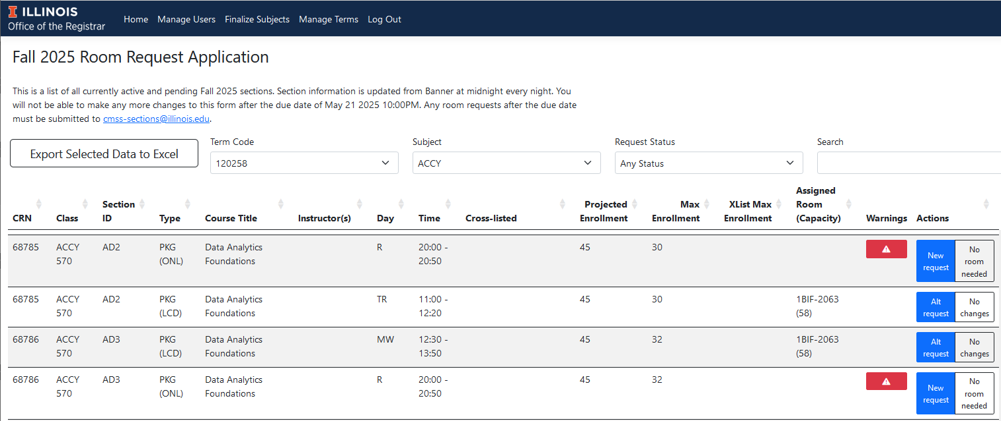
Room Request Application
CMSS sends out the application link to all schedulers to signify the start of the scheduling process for each term.
The application contains all your active and pending section data from Banner, uploaded from Banner the night before.
You only need to fill out the “New Request” or “Alt Request” form if the section needs a new GA room.
The logo leads to the CMSS website.
The due date is listed in the text at the top.
The Request Status pull down can help you filter what still needs to be requested.
It is best to Inactivate all sections which are going from Active to Cancelled first to avoid room or instructor conflicts – delete the room when cancelling
You can export a selection or all the subject’s data to excel.
The Search bar can help you look for specific sections or other data.
Each column can be sorted ascending or descending.
Warnings will help you decide which sections do or do not need a room. Hover for details.

Slide 6
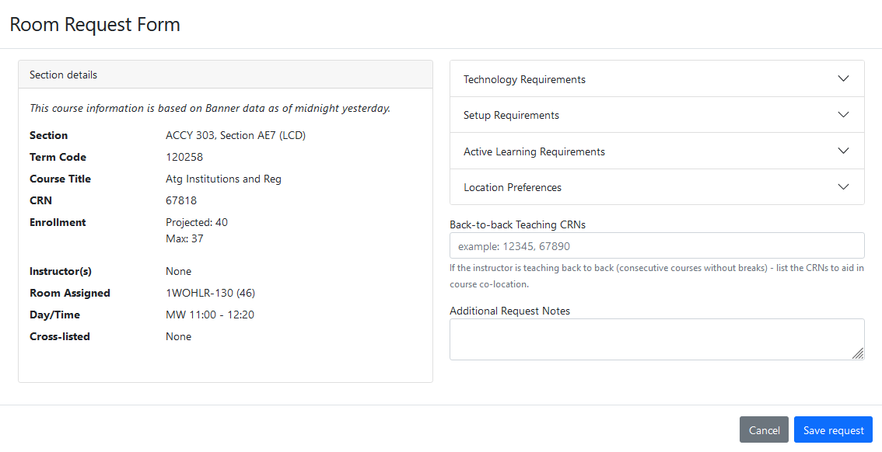
Room Request Application
Choosing “New Request” or “Alt Request” will lead to this form. Completing this form and saving is the only way to request a room.
Each drop down menu has different options. Only select the relevant options, but feel free to clarify in the “other” or “Additional Request Notes” boxes.
Section information is pulled into the application every night at midnight.
Double check the projected and max enrollments are accurate in SSASECT.
Make sure to save your request. You can come back and edit as necessary.
Any changes to Days or Times will delete the request.
Capacities are listed in parentheses for each room.
Note any back-to-back sections here, but only if they follow the back-to-back definition.

Slide 7
Rolled Rooms
Rolled:
  For Fall 27, sections that fell within Standard Teaching times and had a previous (FA 26) fill rate of 60% or higher rolled into the rooms they had in FA 26. All Department space rooms rolled—if your classes are in other department spaces, it is your responsibility to renew permission with that department. We tried to let your rooms roll if you used the space well even if under 60%, as well as blocks of discussion sections that used the space well. Computer Labs do NOT roll.
CMSS Assigns:
  Any Sections needing GA (includes ALC) rooms which did not roll, or that you want to change from the room which rolled (which will require filling out the “Alt Room Request” window)
If you are ok with the room that rolled, leave this room in Banner (SSASECT). Assign all your department space rooms in Banner prior to 1/19/27. If you do not want the room that rolled, remove this room from the Banner meeting row (SSASECT) before 1/19/27, and that will be reflected in the Room Request Application the next day. Only request sections which need new GA rooms (sections which do not have the room entered in Banner).

Slide 8
Active Learning Classrooms
Active Learning Classrooms (ALC), iFlex, Collaborative Spaces, Flex Style Classrooms, etc. are all various ways of referring to these same classrooms.
ALCs use set or flexible seating patterns to allow collaboration between students and instructor.
A list of ALCs (including locations, layouts, and caps) can be found here.
All ALCs require the completion of the Active Learning Classroom drop down tab in the Room Request Window (click “New Room Needed” or “Alt Room Needed” to open the window for that section)
Due to continual high demand, sections not following the standard teaching schedule will have limited options for CIF and ALCs.
Computer Labs Do NOT get reserved through CMSS, reserve these here through ATLAS. Once you have approval through ATLAS, you can email us so the Computer Lab will be listed on Course Explorer.
Unfortunately, requesting an ALC does not guarantee we will have an ALC available because of ever increasing student enrollment numbers, more sections than previous semesters, and limited classrooms.

Slide 9
Miscellaneous Scheduling Information
Instructions for changing the schedule type can be found here.
Guidance for packaging sections (fully in-person, fully online, or a combination) can be found here.
If looking for a new CRN be sure to check SSASECQ in Banner or Catsched or Report 42. DO NOT CREATE A NEW CRN if one is available to re-use. CRNs must keep subject, course number, and XM-OL vs. Standard POT. All other section details can be changed and edited. Any questions please email us first.
CMSS does not handle events. Anything that needs a classroom but is not a section should be directed to fac-reserve@illinois.edu or submitted through Astra here.
We are more heavily discouraging XM-OLs and are strict about what can and cannot be an XM-OL. If the start and end dates are within a week of a standard POT start and end dates, we ask that this be standard POT instead of XM-OL. XM-OLs also cannot cross semesters due to Financial Aid Guidelines, with only very few exceptions.
For those experienced with linking sections, instructions and reminders can be found here.
  If you are new to linking, Contact CMSS.
  If linking sections for a course that has never had linking before, Contact CMSS.

Slide 10
When Changes to Sections Can Be Made
The following can be changed in SSASECT even when students are registered for a section:
  Meeting Days/Times (Your department needs to notify registered students)
  Instructors
  Schedule Type
  Restrictions (in SSARRES)
  The following CANNOT be changed once students are registered (they need to drop and re-add after the change):
  POT (Part of Term)
  Grade Mode
  Credit Hours
  Billing Hours
  Linking

Slide 11
Status | Change | Before Room Requests are Due | After Room Requests are Due
 | Adding room | Can do, but should only add department spaces | Cannot do, must email CMSS
Active/ Pending | Removing room | Can do, the change will drop the room | Cannot do, must email CMSS
 | Time change | Can do, the change will keep the room. But if the section is in a GA space when you change the time, remove the room. Will drop the request in the RR Application | Will drop the room, email CMSS as soon as you make the change so we can add the room back quickly
 | Adding room | Technically can do, but should not if staying inactive/cancelled | Cannot and should not do, even for CMSS
Inactive/ Cancelled | Removing room | Can do, the change will drop the room | Can do, the change will drop the room
 | Time change | Can do but will not drop the room unless you delete the building/room in the meeting row | Can do but will not drop the room unless you delete the building/room in the meeting row
Color Key
Can do
Can do with caveats
Cannot do
Absolutely cannot do
11

Slide 12
Quick Q&A
Where can I find this powerpoint? At the Registrar’s Course Scheduling Page or the Training Page
Do I need to use the Room Request Application?
  Only if you need GA rooms. Only fill out the “New Room Needed” or “Alt Room Needed” windows if the section will need a GA room.
What if all my sections are either in department rooms or are online?
  Enter all department rooms directly in Banner by January 19th. You do not need to use the Room Request App.
What if I need sections to be cross-listed?
  Email CMSS with the CRNs, term, and cross-list max enrollment. Online and in-person sections cannot be cross-listed with each other. Do not put this information into the Room Request Application, as that is not the place for it.
Where can I find capacities for GA classrooms? Capacities and room seating types can be found here, but is also listed in the Room Request application in parentheses behind each room—i. e., CIF 2039 (72).
I do not see my XM-OL sections on the application or in Report 42. What happened?
  XM-OL sections roll inactive, so those CRNs are on cancelled/inactive tab of Report 42. Depts need to verify start and end dates (and adjust if needed) before changing to active. Please use the first day of class as the start date, not the Monday of the first week of an XM-OL class.
Do you have training documentation online? You can access training documentation online Check it out

